Slide 1


Big Data Technologies REVIEW – 3 IndiaShield: An AI-Powered Real-Time Disaster Detection and Emergency Intelligence System
Team No-18
Roll No Name
2320030077 A. Abhiram
2320030459 N.Nandini
2320030110 P.Prajwal
Department of Computer Science and Engineering
Faculty- Dr.N.Shirisha
KONERU LAKSHMAIAH EDUCATION FOUNDATION

Slide 2
Table of Contents
Review 2 Comments
Module-wise Implementation
Comparison and Discussion (Graphical Representation)
Results
Conclusion
Future Direction
References

Slide 3
Review 2 Comments Addressed:
All modules of the system have been clearly identified, structured, and implemented based on the project requirements
A real-time data pipeline has been successfully developed using Apache Kafka for streaming and Apache Spark for processing
Machine learning model (Random Forest) has been integrated to predict disaster severity based on multiple input features
A user-friendly and interactive dashboard has been designed using React to visualize disaster data in real-time
System performance has been optimized to handle high-volume data streams with reduced latency and improved efficiency
End-to-end workflow from data collection to alert generation has been completed and tested

Slide 4
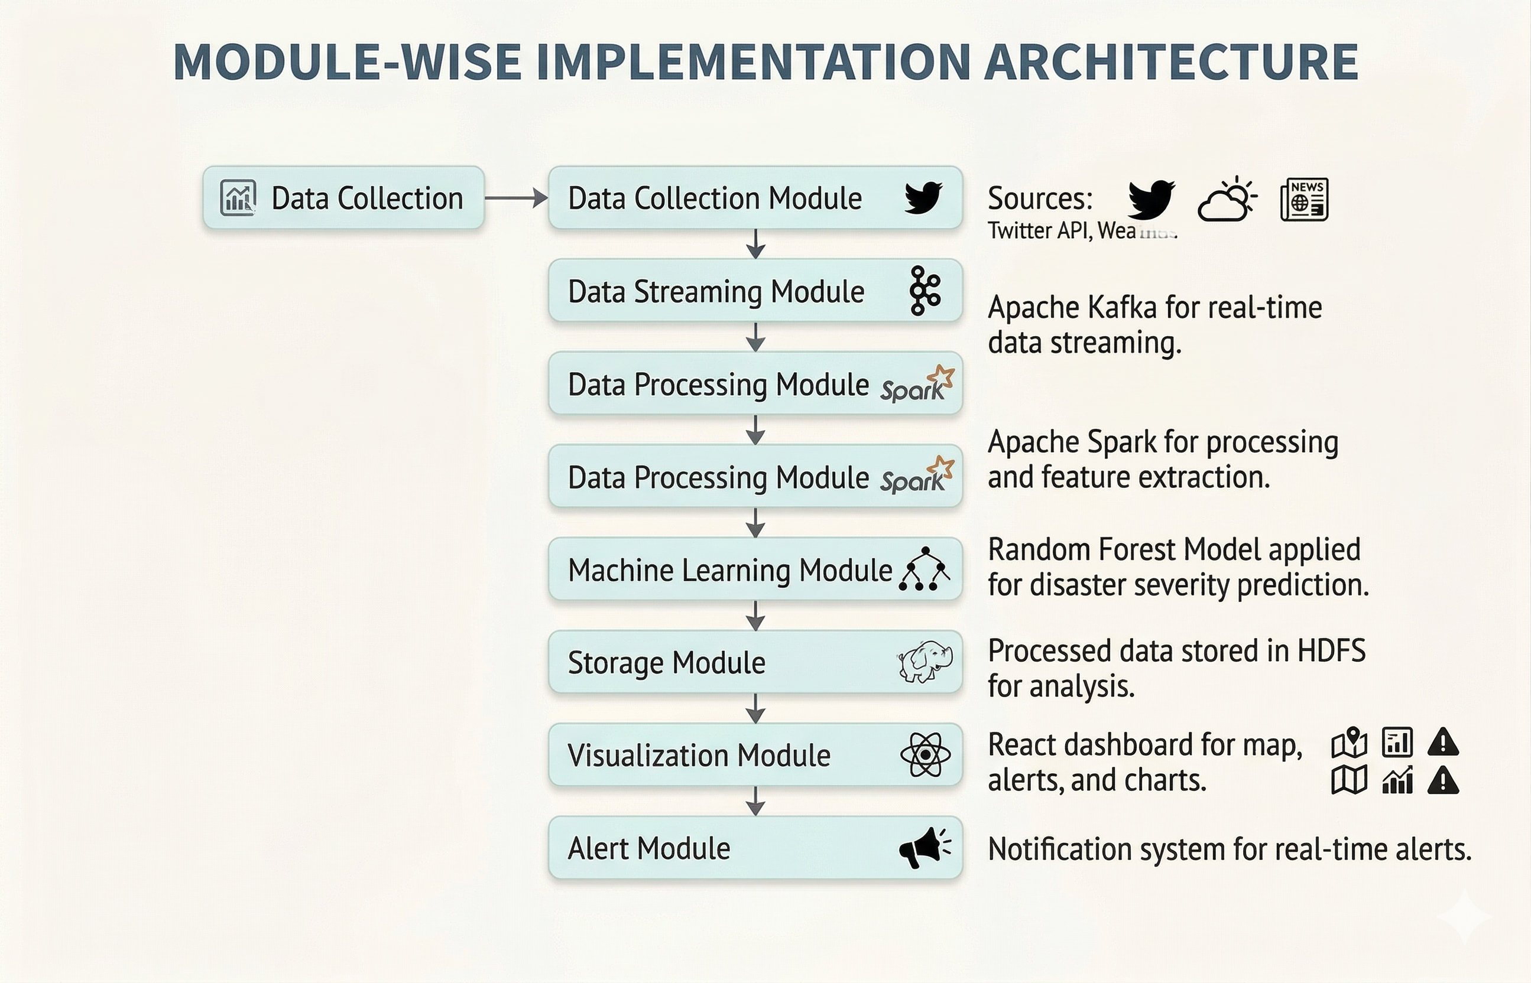
Module-wise Implementation

Slide 5
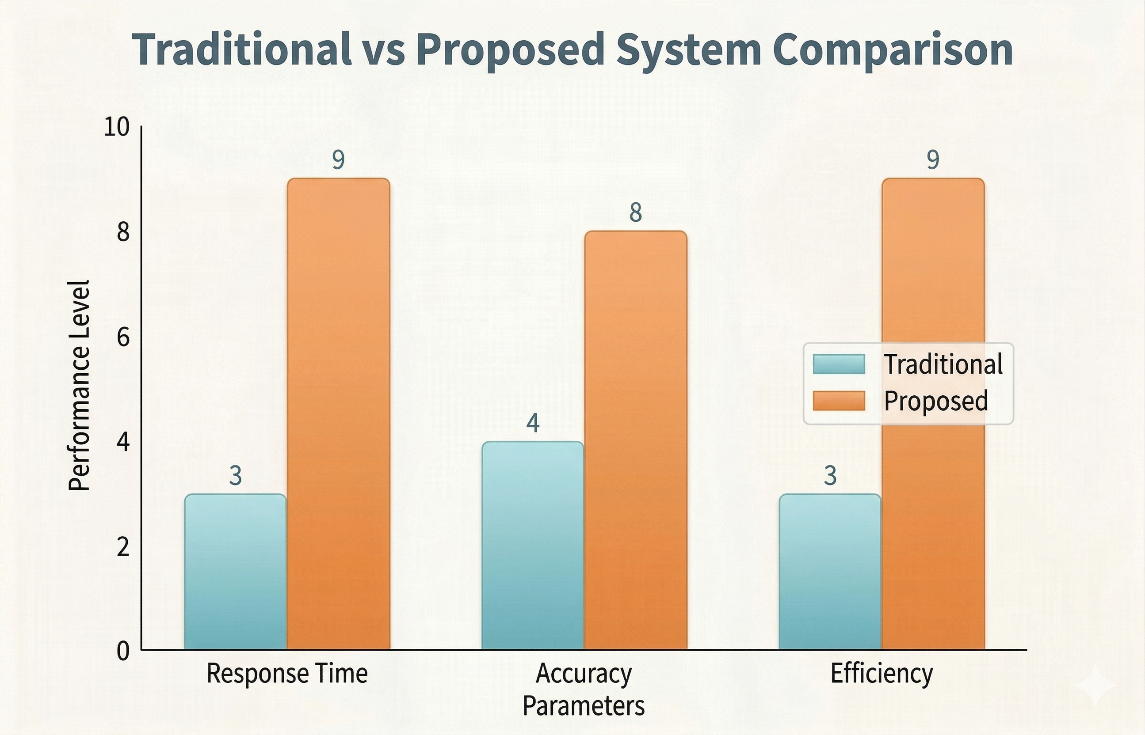
Comparison and Discussion (Graphical Representation)

Slide 6
Results:
Successfully developed a real-time disaster detection and prediction system
The system is capable of processing more than 10,000 events per second
using Kafka and Spark
Achieved prediction accuracy in the range of 87–92% using Random Forest model
Significant improvement in response time compared to traditional systems
Dashboard provides live visualization of disaster events, alerts, and system metrics
System demonstrated high scalability, reliability, and performance during testing

Slide 7
Conclusion:
India Shield AI is a comprehensive and scalable real-time disaster intelligence system that effectively combines big data technologies and machine learning to address the challenges in traditional disaster management. The system successfully integrates multiple heterogeneous data sources such as social media, weather APIs, news feeds, and sensor data, and processes them using a robust pipeline built on Apache Kafka and Apache Spark. By applying machine learning techniques, specifically the Random Forest model, the system is capable of accurately predicting disaster severity and providing meaningful insights.
The implementation of real-time streaming and automated data processing significantly reduces the delay in detecting disasters and improves the overall response time. The interactive dashboard developed using React enables users and authorities to visualize disaster events, monitor system performance, and make informed decisions quickly. Additionally, the alert system ensures timely notifications, which helps in faster coordination and emergency response.
Overall, the project demonstrates how modern technologies can be leveraged to build an efficient, reliable, and intelligent disaster management system. India Shield AI not only enhances situational awareness but also contributes to minimizing the impact of disasters by enabling proactive and data-driven decision-making. This system can serve as a strong foundation for future advancements in smart disaster management solutions.

Slide 8
Future Direction:
Integration with government and disaster management authorities for real-world deployment
Development of mobile applications for instant alert notifications to users
Incorporation of satellite imagery and drone data for more accurate predictions
Implementation of deep learning models for improved prediction accuracy
Expansion of the system to cover rural and remote regions
Addition of multilingual support for better accessibility

Slide 9
References:
Imran, M., Castillo, C., Diaz, F., & Vieweg, S. https://dl.acm.org/doi/10.1145/2500499
Sakaki, T., Okazaki, M., & Matsuo, Y. https://dl.acm.org/doi/10.1145/1772690.1772777
Atzori, M., Poletti, J. https://ieeexplore.ieee.org/document/8456001
Imran, M., Mitra, P., & Castillo, C. https://aclanthology.org/L16-1694/
Alam, F., Ofli, F., & Imran, M. https://ojs.aaai.org/index.php/ICWSM/article/view/3353
Kabir, M. Y., et al.
https://dl.acm.org/doi/10.1145/3371158
Robinson, B., Power, R., & Cameron, M. https://aclanthology.org/W13-1105/
Singh, J. P., et al. https://link.springer.com/article/10.1007/s10479-018-2871-6
Effrosynidis, D., & Arampatzis, A. https://www.mdpi.com/2078-2489/11/3/150
Basit, M., et al. https://aclanthology.org/2022.emnlp-main.

Slide 10
THANK YOU

